Slide 1


Slide 2
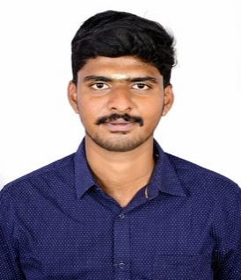
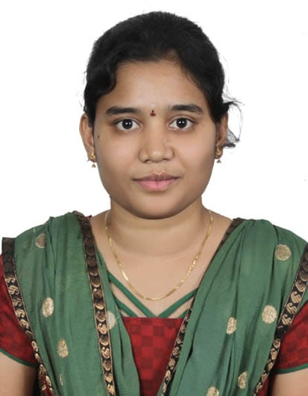
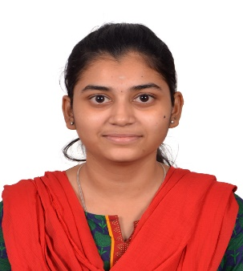
Project Highlights
Project Name : D News
Team Size : 3
BU Mentor Name : Mentor PS#
Team Members Details:
Visvak Kumar T S
99002785
2009MYSSPS02
BE Computer Science, CIT
Professional Skills- Python , Android, Node Js, Web Development
Divya P
99002775
2009MYSSPS02
B.E. CSE, PSG Institute of Technology and Applied Research
Skills-C, HTML,CSS, Android
Binduja S
99002756
2009MYSSPS02
B. Tech IT, Sri Ramakrishna Engineering College
Professional Skills- Python, C, HTML, CSS, JAVA SCRIPT

Slide 3
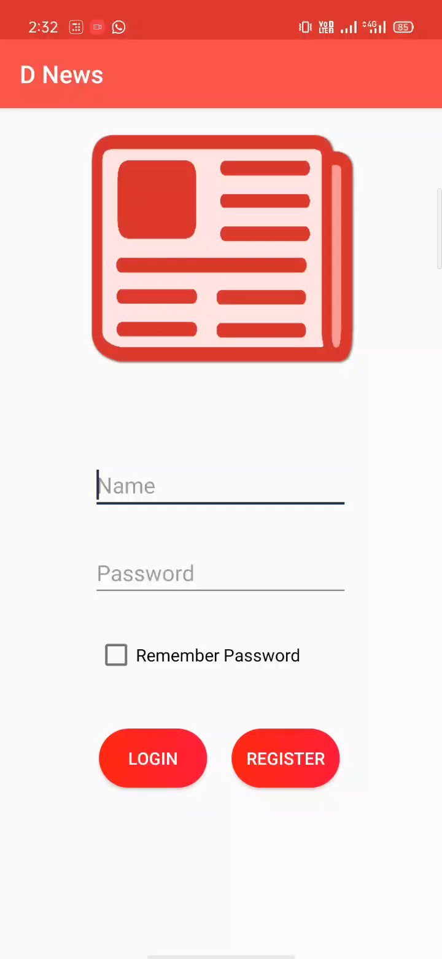
Project Video Snippet

Slide 4
Future development that can be implemented further
Search category by topic i.e. sports, entertainment, health, politics, etc..
Add channels - example (BBC news, India today, etc..)

Slide 5


Thank You !

